Slide 1
HOW TO MAKE A GOOD CV AND COVER LETTER IN ENGLISH

Slide 2
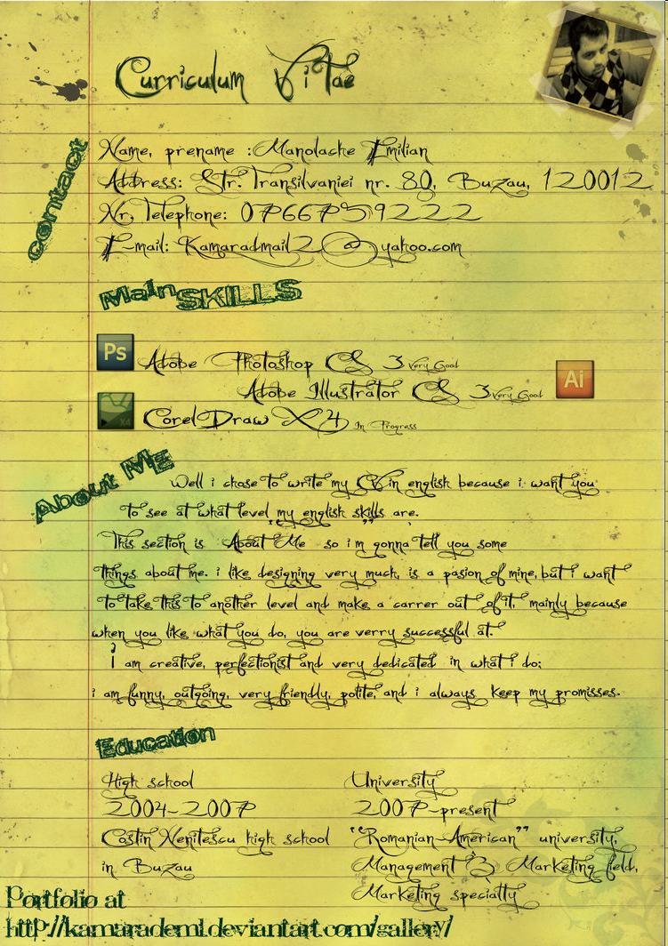
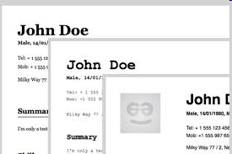
Curriculum vitae
Literally meaning ‘the course of one’s life’
Sets out your:
  Personal details,
  Education,
  Qualifucation,
  Working experience.

Slide 3
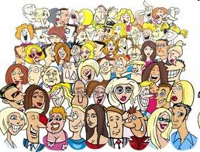

A CV is your way of saying
“Hey! This is me! I could make a contribution to your business!”
Sounds easy, right?

Slide 4
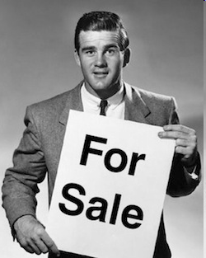

Toughest challenge
an average, just 8 seconds to sell yourself to a potential employer
two pages of A4 paper

Slide 5
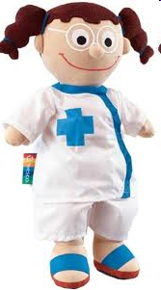

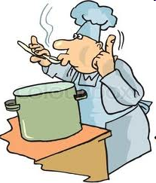

Don’t waffle
Don’t underplay your skills
Don’t lie
Just be honest –
be YOU

Slide 6
What should you include?
Personal details
Education and qualifications
Work History
Interests and achievements
Skills
References
Objectives

Slide 7
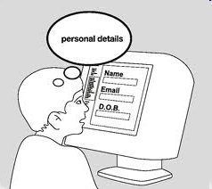
Personal details
Name
Address
Date of birth
Telephone number
Email

Slide 8


Education and qualifications
name of the university
dates studied
name of the degree or major subjects
certificates

Slide 9

Work History
A chronological list
Only related jobs should be posted

Slide 10
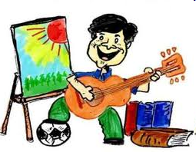
Interests and achievements
Don't use the old boring cliches here: “socialising with friends”.
Hobbies that are a little out of the ordinary can help you to stand out from the crowd.
Any interests relevant to the job are worth mentioning.

Slide 11

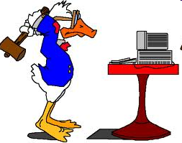

Skills
Languages,
Computing,
Driving

Slide 12

References
Normally two referees are sufficient
  academic
  from an employer

Slide 13


Objectives
You can state your career related objectives

Slide 14

Europass CV
standard CV format
present your skills and qualifications effectively and clearly
can be completed in 26 different languages
http://europass.cedefop.europa.eu/en/home

Slide 15
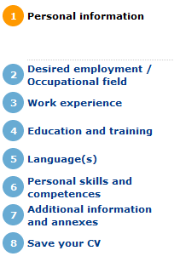
http://europass.cedefop.europa.eu/en/home
You only need 8 steps to complete your CV

Slide 16
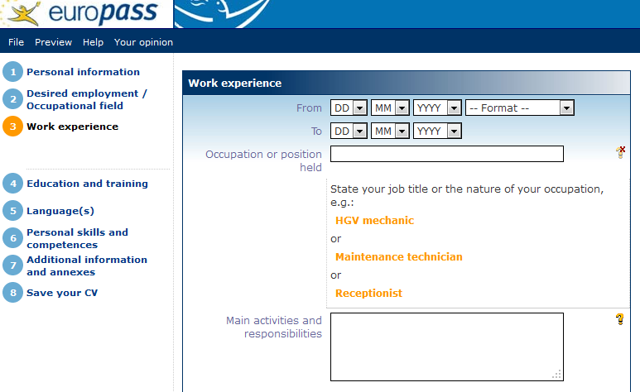
http://europass.cedefop.europa.eu/en/home

Slide 17
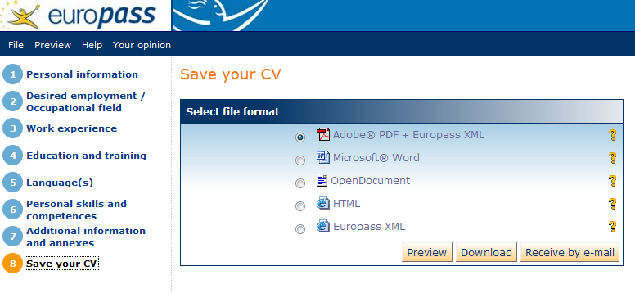
http://europass.cedefop.europa.eu/en/home

Slide 18
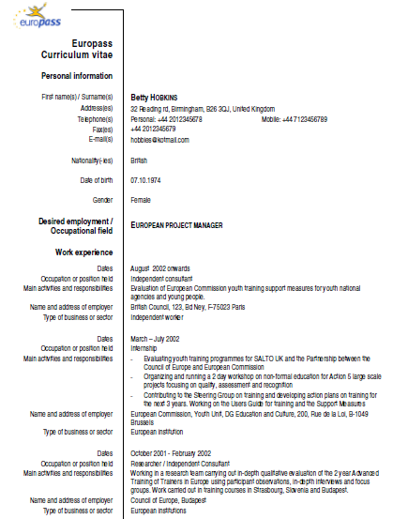
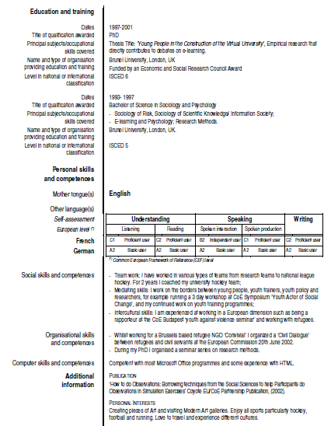

Slide 19

What is a cover letter?
A cover letter is a document sent with your resume to provide additional information on your skills and experience.
  why you are qualified
  explain the reasons
  identify your most relevant skills
  one page at most in length

Slide 20
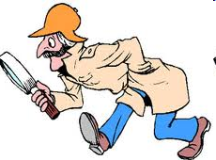
Do your research
on the company
into the role to which you are applying
allow you to use style and terminology
The covering letter puts flesh on the bare bones of the CV.

Slide 21
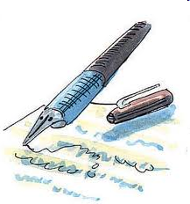
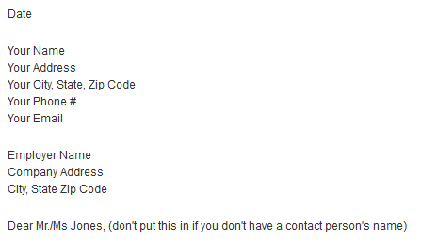
Header

Slide 22

Body of Letter
  The First Paragraph
  The Middle Paragraphs
  The Last Paragraph

Slide 23

The First Paragraph
name of the job you are seeking
any mutual contact
short paragraph

Slide 24
The Middle Paragraphs
Why you are interested in the job?
What you can do for the company?
  Outline a relevant career goal
Why should an employer be interested in hiring you?
  Give evidence of your experience

Slide 25

The Last Paragraph
Thank the employer for his or her time
Request actions
  desire for a personal interview
  state what you will do to follow up, such as telephone the employer within two weeks
“I look forward to hearing from you”

Slide 26

Closing
Yours sincerely (when you know the person’s name)
Yours faithfully (when you don’t know the person’s name)
[your name]

Slide 27

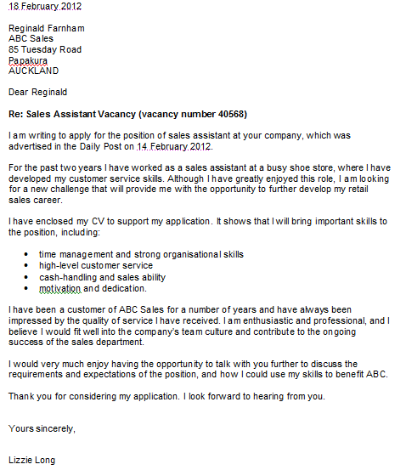

Slide 28
Two sets of eyes are better than one
Candidate included weight and all allergies.
Candidate wrote résumé as a play - Act 1, Act 2, etc.
Candidate specified emergency contact as the hospital.
Candidate explained the need for multiple bathroom breaks each hour.
Candidate included a letter from his mother.
“One applicant used colored paper and drew glitter designs around the border”
Achievements: “Nominated for prom queen”
A resume… was printed on the back of the person’s current employer’s letterhead.
Hobbies: “Having a good time”
Reason for leaving last job: “Maturity leave.”
“Am a perfectionist and rarely if if ever forget details.”
“Let’s meet, so you can ‘ooh’ and ‘aah’ over my experience.”
Interests: “Gossiping.”
Skills: “I can type without looking at thekeyboard.”
Skills: “I have technical skills that will take your breath away.”
Education: “I possess a moderate education but willing to learn more.”
Salary requirements: “The higher the better.”
References: “Bill, Tom, Eric. But I don’t know their phone numbers.”
References: “Please do not contact my immediate supervisor at the company. My colleagues will give me a better reference.”
Objective: “Student today. Vice president tomorrow.”
Personal: “I am loyal and know when to keep my big mouth shut.”
Job duties: “Filing, billing, printing and coping.”

